Slide 1
Ethereum Sharding
General Introduction
Ethereum Research
Hsiao-Wei Wang and Karl Floersch
2018 March 19th

Slide 2
Sharding

Slide 3
Sharding
Scaling Solution!

Slide 4
Sharding
A Secure and Decentralized Scaling Solution!

Slide 5
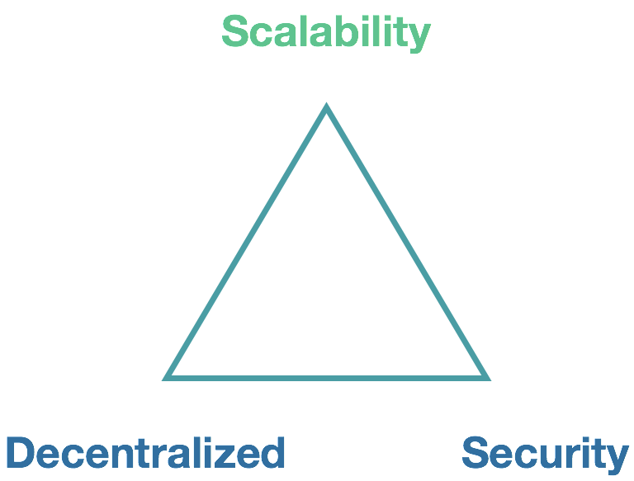

Sharding
A Secure and Decentralized Scaling Solution!
How secure are you talking about?

Slide 6
Sharding
A Secure and Decentralized Scaling Solution!
How secure are you talking about?
Spoiler! Day 3 - Security Models Mechanism Design

Slide 7
Main Chain
The main Ethereum blockchain

Slide 8
Shard Chain
Create many new shard chains
Each shard chain is a new galaxy

Slide 9
Main Chain
Shard 1
Shard 2
….
Shard 100

Slide 10
Scaling Goal
Scaling: The VISA level transaction rate
Usability:
Cross-contracts transaction
Cross-shards transaction
Tight coupling

Slide 11
Compatibilities

Slide 12
Tight coupling
Cross-shard transactions
State execution
Disable state execution

Slide 13
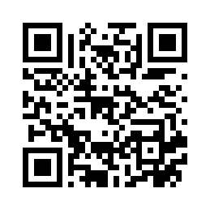
Sharding Phase 1
v2
Non-transactional Shard
https://ethresear.ch/t/1407

Slide 14
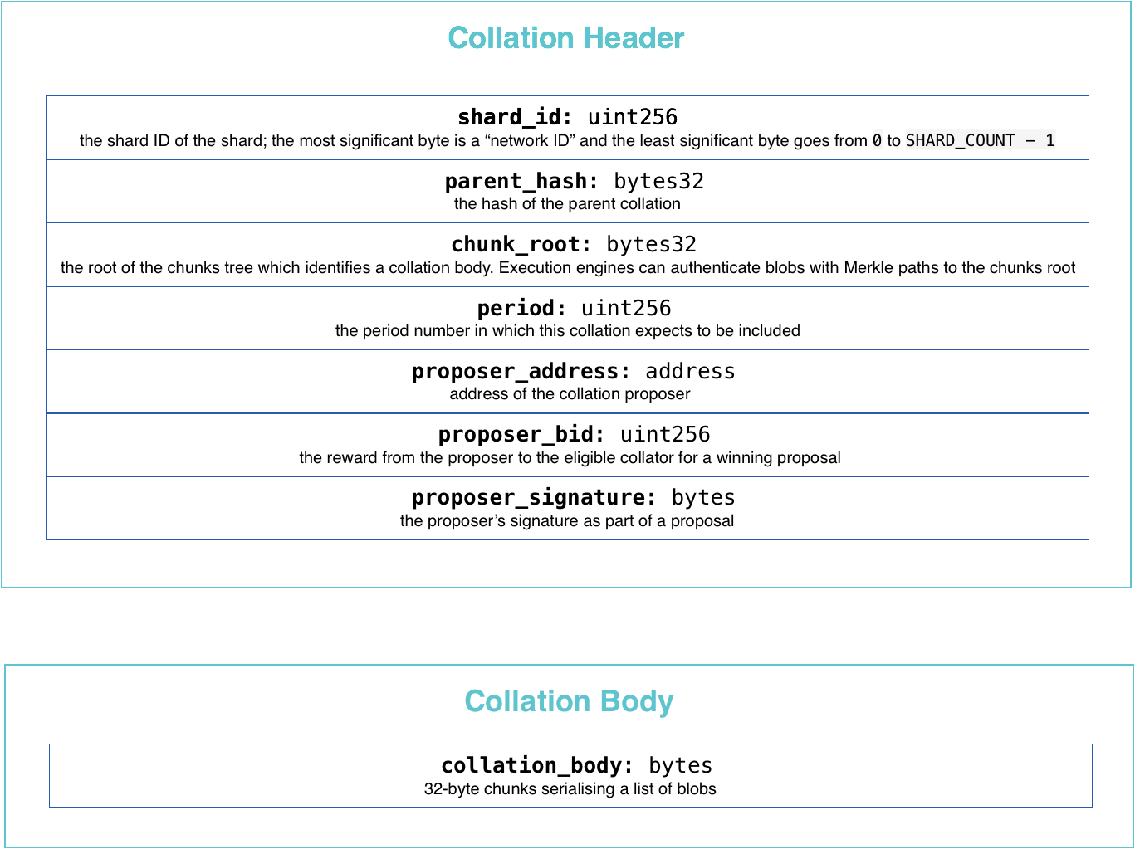
Collation
Collation
like block!

Slide 15
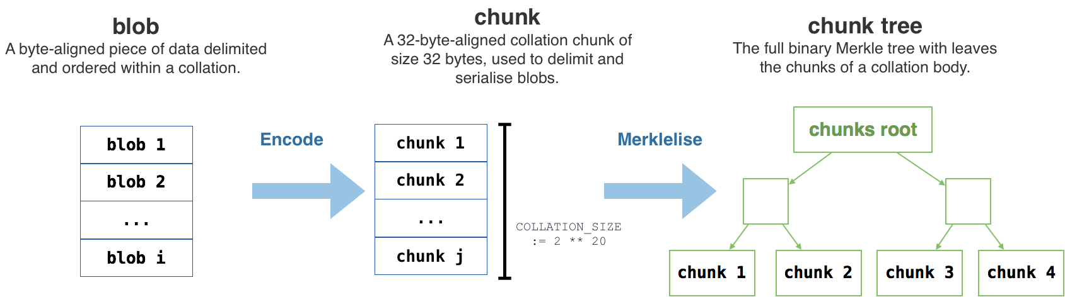
Blobs and Chunks

Slide 16
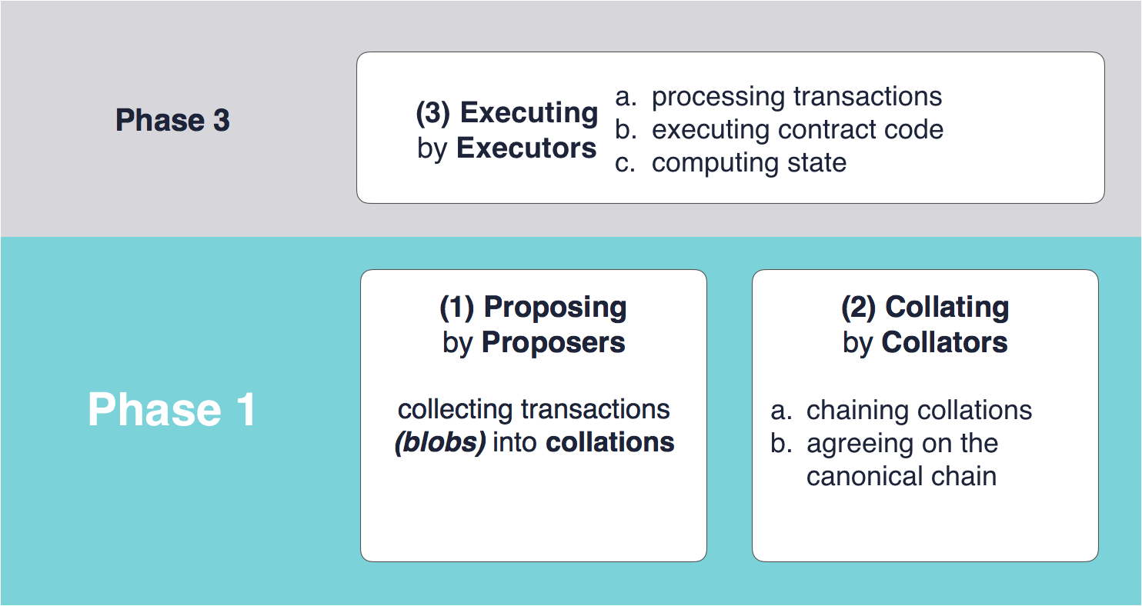
Spoiler! Day 1 Proposer / Collator Separation
Two Layers and Three Processes

Slide 17
Spoiler! Day 1 Proposer / Collator Separation
Anyone could be a proposer
Maintains transaction pools
Collects the transactions to prepares the proposal (collatinon header)
Publishes/Reveals the collation body
Proposer

Slide 18
Spoiler! Day 1 Proposer / Collator Separation
Collator
Is pseudo-randomly sampled as the eligible collator of “the specific shard and the specific period” from the collator pool of all shards
Collates the proposal to build the collation

Slide 19
Spoiler! Day 1 Execution
Executor
Executes the state transition function
Proposers are supposed to be the executors too to have to abilities to know the consuming gas of transactions and select transactions with high fee

Slide 20
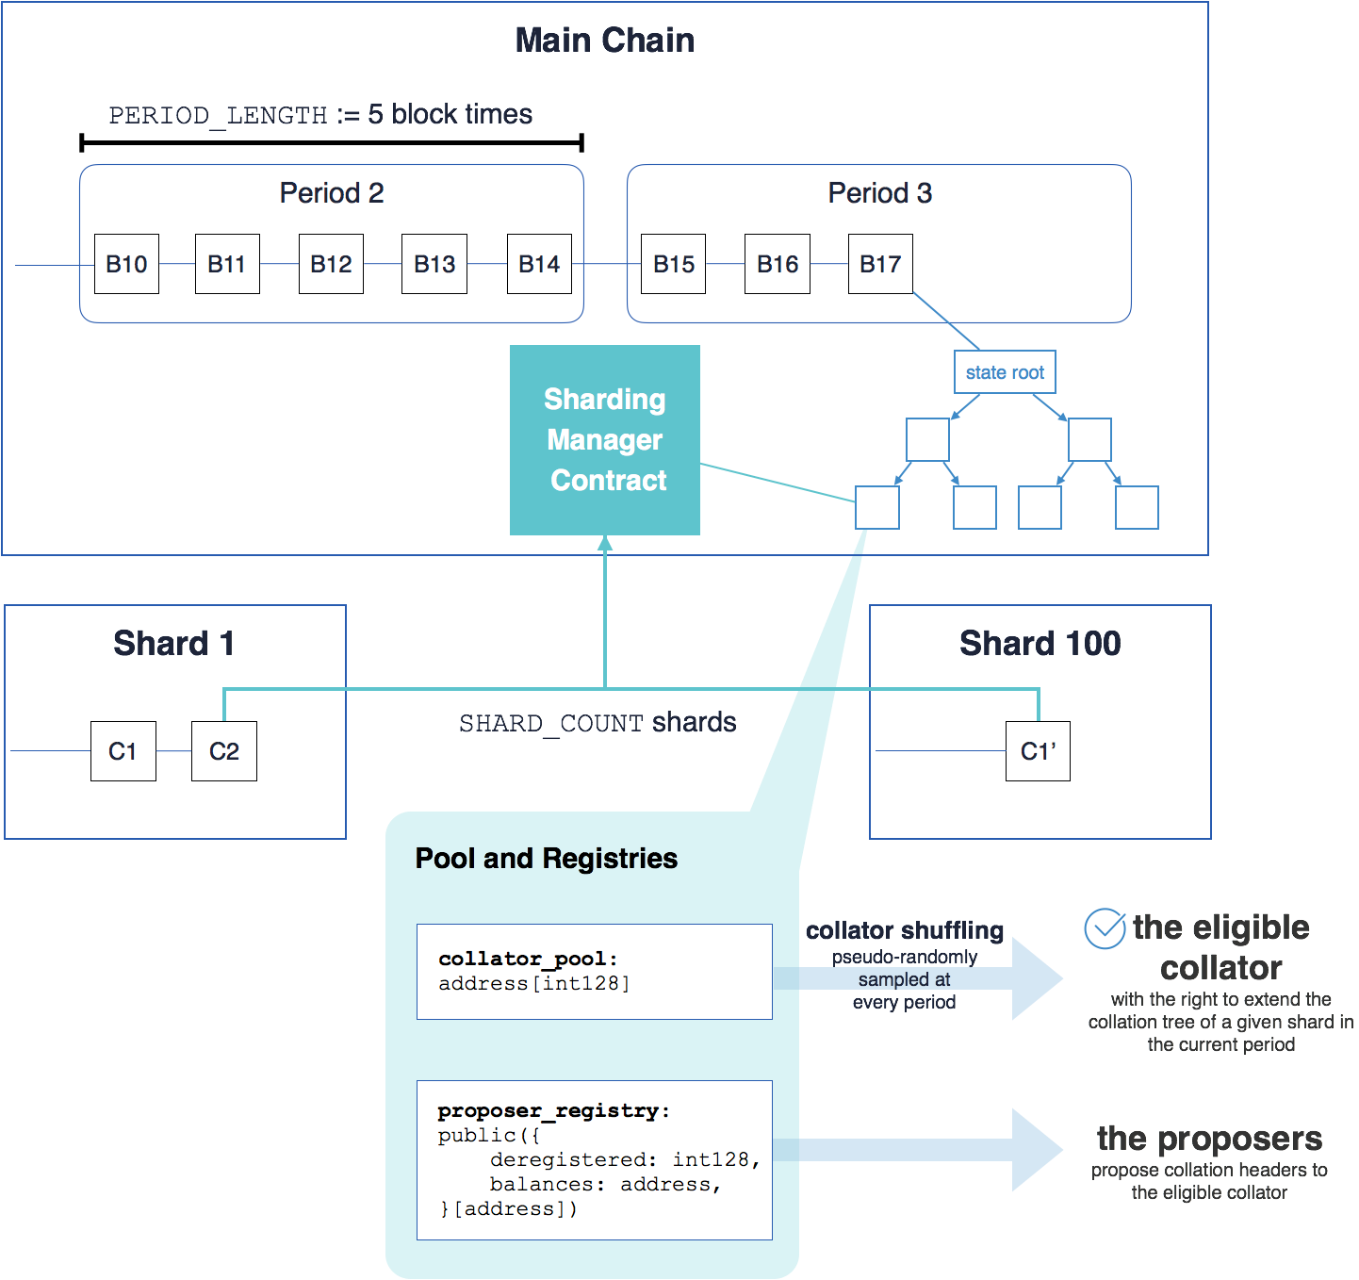
Spoiler! Day 1 Sharding Manager Contract
Sharding
Manager
Contract (SMC)

Slide 21
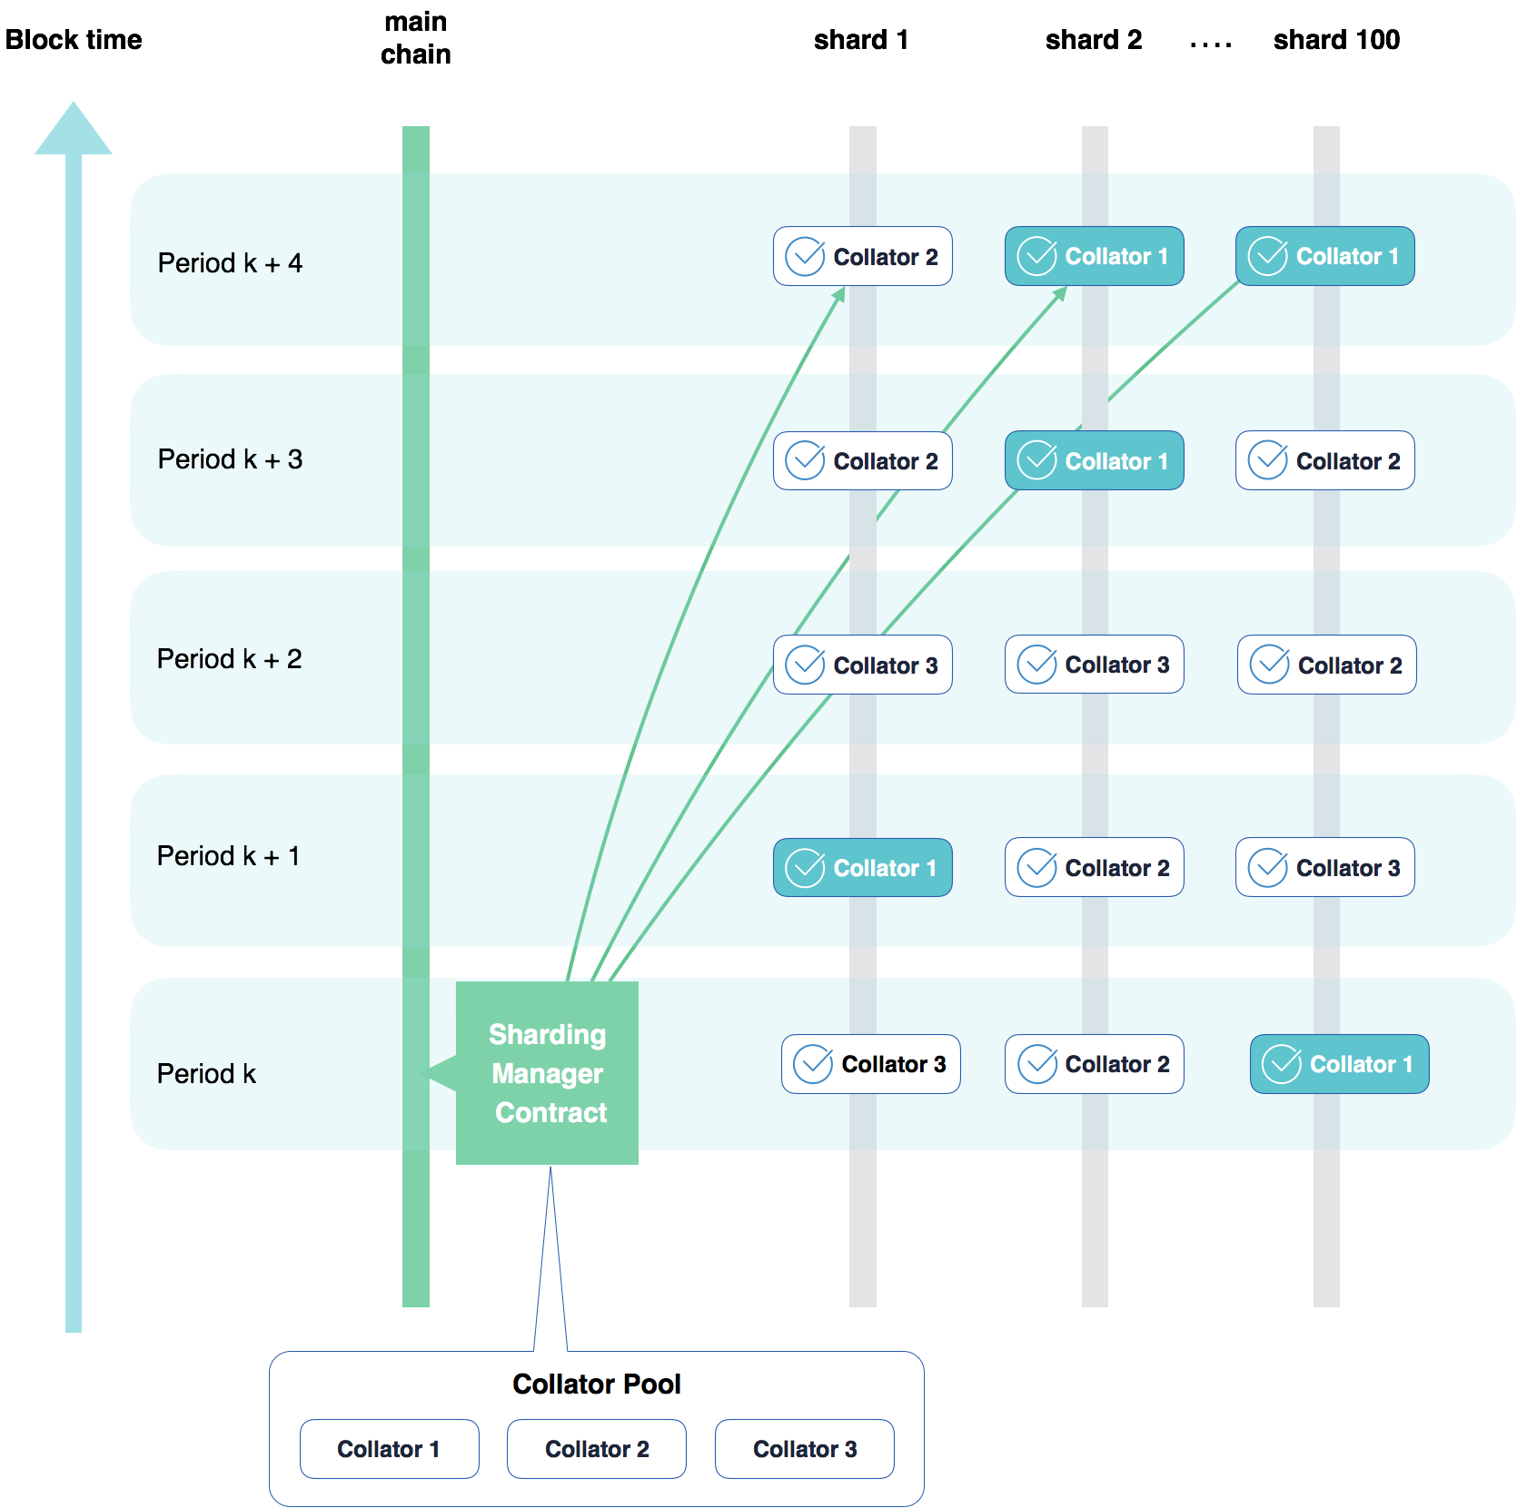
Lookahead

Slide 22
Karl Slides

Slide 23



Sharding Phase 1
Root chain
Shard 1
Shard 2
Shard 3
Notes:
Maybe these shouldn’t be blocks but instead periods?
Then do some dotted line boxes for the LOOKAHEAD functions
Show 3 shards
Randomly sample validator / show which random validators go for each period
Actually build the chains
Show the validators downloading the state from some state storage thing
Mention removal of gas for storage and how useful that is
Show the validators checking block validity some depth
Propose invalid block
Show forking
Talk about how we will remove forking
Show user sending transaction, providing access list and whitness data

Slide 24


Sharding Phase 1
Root chain
Each circle represents 1 period, which is 5 blocks
Shard 1
Shard 2
Shard 3
Notes:
Maybe these shouldn’t be blocks but instead periods?
Then do some dotted line boxes for the LOOKAHEAD functions
Show 3 shards
Randomly sample validator / show which random validators go for each period
Actually build the chains
Show the validators downloading the state from some state storage thing
Mention removal of gas for storage and how useful that is
Show the validators checking block validity some depth
Propose invalid block
Show forking
Talk about how we wil remove forking
Show user sending transaction, providing access list and whitness data

Slide 25
Sharding Phase 1
Root chain
Shard 1
Shard 2
Shard 3
Notes:
Maybe these shouldn’t be blocks but instead periods?
Then do some dotted line boxes for the LOOKAHEAD functions
Show 3 shards
Randomly sample validator / show which random validators go for each period
Actually build the chains
Show the validators downloading the state from some state storage thing
Mention removal of gas for storage and how useful that is
Show the validators checking block validity some depth
Propose invalid block
Show forking
Talk about how we will remove forking
Show user sending transaction, providing access list and whitness data

Slide 26
Sharding Phase 1
Validator LOOKAHEAD
Client txs
Proposers create collation
Validators download collations & verify availability
Validators submit collation header to the root chain
Evil validator submits invalid collation
Build on separate fork
Root chain
Shard 1
Shard 2
Shard 3
Notes:
Maybe these shouldn’t be blocks but instead periods?
Then do some dotted line boxes for the LOOKAHEAD functions
Show 3 shards
Randomly sample validator / show which random validators go for each period
Actually build the chains
Show the validators downloading the state from some state storage thing
Mention removal of gas for storage and how useful that is
Show the validators checking block validity some depth
Propose invalid block
Show forking
Talk about how we will remove forking
Show user sending transaction, providing access list and whitness data

Slide 27

Sharding Phase 1
Validators use LOOKAHEAD to check which shards they will be validating in the near future
Client submits transactions to collation proposers
Collation proposers create collations which pay a fee to validators
Validators download potential collation proposals
Validators verify availability until some depth and pick head to build on
Validators submit collation header to the root chain
Evil validator submits invalid collation
Next validator notices and builds on separate fork
Root chain
Shard 1
Shard 2
Shard 3
Notes:
Maybe these shouldn’t be blocks but instead periods?
Then do some dotted line boxes for the LOOKAHEAD functions
Show 3 shards
Randomly sample validator / show which random validators go for each period
Actually build the chains
Show the validators downloading the state from some state storage thing
Mention removal of gas for storage and how useful that is
Show the validators checking block validity some depth
Propose invalid block
Show forking
Talk about how we will remove forking
Show user sending transaction, providing access list and whitness data

Slide 28
Sharding Phase 1
Root chain
LOOKAHEAD_PERIODS = 4
LOOKAHEAD allows validators to check which shards they will be validating in advance
Shard 1
Shard 2
Shard 3
Notes:
Maybe these shouldn’t be blocks but instead periods?
Then do some dotted line boxes for the LOOKAHEAD functions
Show 3 shards
Randomly sample validator / show which random validators go for each period
Actually build the chains
Show the validators downloading the state from some state storage thing
Mention removal of gas for storage and how useful that is
Show the validators checking block validity some depth
Propose invalid block
Show forking
Talk about how we will remove forking
Show user sending transaction, providing access list and whitness data

Slide 29
Sharding Phase 1
Root chain
LOOKAHEAD_PERIODS = 4
Shard 1
Shard 2
Shard 3
Notes:
Maybe these shouldn’t be blocks but instead periods?
Then do some dotted line boxes for the LOOKAHEAD functions
Show 3 shards
Randomly sample validator / show which random validators go for each period
Actually build the chains
Show the validators downloading the state from some state storage thing
Mention removal of gas for storage and how useful that is
Show the validators checking block validity some depth
Propose invalid block
Show forking
Talk about how we will remove forking
Show user sending transaction, providing access list and whitness data

Slide 30
Sharding Phase 1
Root chain
LOOKAHEAD_PERIODS = 4
Shard 1
Shard 2
Shard 3
Notes:
Maybe these shouldn’t be blocks but instead periods?
Then do some dotted line boxes for the LOOKAHEAD functions
Show 3 shards
Randomly sample validator / show which random validators go for each period
Actually build the chains
Show the validators downloading the state from some state storage thing
Mention removal of gas for storage and how useful that is
Show the validators checking block validity some depth
Propose invalid block
Show forking
Talk about how we will remove forking
Show user sending transaction, providing access list and whitness data

Slide 31
Sharding Phase 1
Root chain
LOOKAHEAD_PERIODS = 4
Shard 1
Shard 2
Shard 3
Notes:
Maybe these shouldn’t be blocks but instead periods?
Then do some dotted line boxes for the LOOKAHEAD functions
Show 3 shards
Randomly sample validator / show which random validators go for each period
Actually build the chains
Show the validators downloading the state from some state storage thing
Mention removal of gas for storage and how useful that is
Show the validators checking block validity some depth
Propose invalid block
Show forking
Talk about how we will remove forking
Show user sending transaction, providing access list and whitness data

Slide 32
Sharding Phase 1
Root chain
LOOKAHEAD_PERIODS = 4
Shard 1
Shard 2
Shard 3
Notes:
Maybe these shouldn’t be blocks but instead periods?
Then do some dotted line boxes for the LOOKAHEAD functions
Show 3 shards
Randomly sample validator / show which random validators go for each period
Actually build the chains
Show the validators downloading the state from some state storage thing
Mention removal of gas for storage and how useful that is
Show the validators checking block validity some depth
Propose invalid block
Show forking
Talk about how we will remove forking
Show user sending transaction, providing access list and whitness data

Slide 33
Sharding Phase 1
Root chain
Shard 1
Shard 2
Shard 3
Notes:
Maybe these shouldn’t be blocks but instead periods?
Then do some dotted line boxes for the LOOKAHEAD functions
Show 3 shards
Randomly sample validator / show which random validators go for each period
Actually build the chains
Show the validators downloading the state from some state storage thing
Mention removal of gas for storage and how useful that is
Show the validators checking block validity some depth
Propose invalid block
Show forking
Talk about how we will remove forking
Show user sending transaction, providing access list and whitness data

Slide 34
Sharding Phase 1
Validators use LOOKAHEAD to check which shards they will be validating in the near future
Client submits transactions to collation proposers
Collation proposers create collations which pay a fee to validators
Validators download potential collation proposals
Validators verify availability until some depth and pick head to build on
Validators submit collation header to the root chain
Evil validator submits invalid collation
Next validator notices and builds on separate fork
Root chain
Shard 1
Shard 2
Shard 3
Notes:
Maybe these shouldn’t be blocks but instead periods?
Then do some dotted line boxes for the LOOKAHEAD functions
Show 3 shards
Randomly sample validator / show which random validators go for each period
Actually build the chains
Show the validators downloading the state from some state storage thing
Mention removal of gas for storage and how useful that is
Show the validators checking block validity some depth
Propose invalid block
Show forking
Talk about how we will remove forking
Show user sending transaction, providing access list and whitness data

Slide 35


Sharding Phase 1
Tx pool
Shard 1
Shard 2
Shard 3
Notes:
Maybe these shouldn’t be blocks but instead periods?
Then do some dotted line boxes for the LOOKAHEAD functions
Show 3 shards
Randomly sample validator / show which random validators go for each period
Actually build the chains
Show the validators downloading the state from some state storage thing
Mention removal of gas for storage and how useful that is
Show the validators checking block validity some depth
Propose invalid block
Show forking
Talk about how we will remove forking
Show user sending transaction, providing access list and whitness data

Slide 36
Sharding Phase 1
Validators use LOOKAHEAD to check which shards they will be validating in the near future
Client submits transactions to collation proposers
Collation proposers create collations which pay a fee to validators
Validators download potential collation proposals
Validators verify availability until some depth and pick head to build on
Validators submit collation header to the root chain
Evil validator submits invalid collation
Next validator notices and builds on separate fork
Root chain
Shard 1
Shard 2
Shard 3
Notes:
Maybe these shouldn’t be blocks but instead periods?
Then do some dotted line boxes for the LOOKAHEAD functions
Show 3 shards
Randomly sample validator / show which random validators go for each period
Actually build the chains
Show the validators downloading the state from some state storage thing
Mention removal of gas for storage and how useful that is
Show the validators checking block validity some depth
Propose invalid block
Show forking
Talk about how we will remove forking
Show user sending transaction, providing access list and whitness data

Slide 37
Sharding Phase 1
Tx pool
Shard 1
Shard 2
Shard 3
Notes:
Maybe these shouldn’t be blocks but instead periods?
Then do some dotted line boxes for the LOOKAHEAD functions
Show 3 shards
Randomly sample validator / show which random validators go for each period
Actually build the chains
Show the validators downloading the state from some state storage thing
Mention removal of gas for storage and how useful that is
Show the validators checking block validity some depth
Propose invalid block
Show forking
Talk about how we will remove forking
Show user sending transaction, providing access list and whitness data

Slide 38

Sharding Phase 1
Collation pool
Tx pool
Shard 1
Shard 2
Shard 3
Notes:
Maybe these shouldn’t be blocks but instead periods?
Then do some dotted line boxes for the LOOKAHEAD functions
Show 3 shards
Randomly sample validator / show which random validators go for each period
Actually build the chains
Show the validators downloading the state from some state storage thing
Mention removal of gas for storage and how useful that is
Show the validators checking block validity some depth
Propose invalid block
Show forking
Talk about how we will remove forking
Show user sending transaction, providing access list and whitness data

Slide 39
Sharding Phase 1
Collation pool
Tx pool
Shard 1
Shard 2
Shard 3
Notes:
Maybe these shouldn’t be blocks but instead periods?
Then do some dotted line boxes for the LOOKAHEAD functions
Show 3 shards
Randomly sample validator / show which random validators go for each period
Actually build the chains
Show the validators downloading the state from some state storage thing
Mention removal of gas for storage and how useful that is
Show the validators checking block validity some depth
Propose invalid block
Show forking
Talk about how we will remove forking
Show user sending transaction, providing access list and whitness data

Slide 40
Sharding Phase 1
Validators use LOOKAHEAD to check which shards they will be validating in the near future
Client submits transactions to collation proposers
Collation proposers create collations which pay a fee to validators
Validators download potential collation proposals
Validators verify availability until some depth and pick head to build on
Validators submit collation header to the root chain
Evil validator submits invalid collation
Next validator notices and builds on separate fork
Root chain
Shard 1
Shard 2
Shard 3
Notes:
Maybe these shouldn’t be blocks but instead periods?
Then do some dotted line boxes for the LOOKAHEAD functions
Show 3 shards
Randomly sample validator / show which random validators go for each period
Actually build the chains
Show the validators downloading the state from some state storage thing
Mention removal of gas for storage and how useful that is
Show the validators checking block validity some depth
Propose invalid block
Show forking
Talk about how we will remove forking
Show user sending transaction, providing access list and whitness data

Slide 41
Sharding Phase 1
Collation pool
Tx pool
Shard 1
Shard 2
Shard 3
Notes:
Maybe these shouldn’t be blocks but instead periods?
Then do some dotted line boxes for the LOOKAHEAD functions
Show 3 shards
Randomly sample validator / show which random validators go for each period
Actually build the chains
Show the validators downloading the state from some state storage thing
Mention removal of gas for storage and how useful that is
Show the validators checking block validity some depth
Propose invalid block
Show forking
Talk about how we will remove forking
Show user sending transaction, providing access list and whitness data

Slide 42
Sharding Phase 1
Collation pool
Tx pool
Shard 1
Shard 2
Shard 3
Notes:
Maybe these shouldn’t be blocks but instead periods?
Then do some dotted line boxes for the LOOKAHEAD functions
Show 3 shards
Randomly sample validator / show which random validators go for each period
Actually build the chains
Show the validators downloading the state from some state storage thing
Mention removal of gas for storage and how useful that is
Show the validators checking block validity some depth
Propose invalid block
Show forking
Talk about how we will remove forking
Show user sending transaction, providing access list and whitness data

Slide 43


Sharding Phase 1
Download state for relevant shard
Validators use LOOKAHEAD to check which shards they will be validating in the near future
Client submits transactions to collation proposers
Collation proposers create collations which pay a fee to validators
Validators download potential collation proposals
Validators verify availability until some depth and pick head to build on
Validators submit collation header to the root chain
Evil validator submits invalid collation
Next validator notices and builds on separate fork
Root chain
Shard 1
Shard 2
Shard 3
Notes:
Maybe these shouldn’t be blocks but instead periods?
Then do some dotted line boxes for the LOOKAHEAD functions
Show 3 shards
Randomly sample validator / show which random validators go for each period
Actually build the chains
Show the validators downloading the state from some state storage thing
Mention removal of gas for storage and how useful that is
Show the validators checking block validity some depth
Propose invalid block
Show forking
Talk about how we will remove forking
Show user sending transaction, providing access list and whitness data

Slide 44
Sharding Phase 1
Collation pool
Tx pool
Root chain
Shard 1
Shard 2
Shard 3
Notes:
Maybe these shouldn’t be blocks but instead periods?
Then do some dotted line boxes for the LOOKAHEAD functions
Show 3 shards
Randomly sample validator / show which random validators go for each period
Actually build the chains
Show the validators downloading the state from some state storage thing
Mention removal of gas for storage and how useful that is
Show the validators checking block validity some depth
Propose invalid block
Show forking
Talk about how we will remove forking
Show user sending transaction, providing access list and whitness data

Slide 45
Sharding Phase 1
Collation pool
Tx pool
Root chain
Verify
Verify
Verify
Shard 1
Shard 2
Shard 3
Notes:
Maybe these shouldn’t be blocks but instead periods?
Then do some dotted line boxes for the LOOKAHEAD functions
Show 3 shards
Randomly sample validator / show which random validators go for each period
Actually build the chains
Show the validators downloading the state from some state storage thing
Mention removal of gas for storage and how useful that is
Show the validators checking block validity some depth
Propose invalid block
Show forking
Talk about how we will remove forking
Show user sending transaction, providing access list and whitness data

Slide 46
Sharding Phase 1
Collation pool
Tx pool
Root chain
Verify
Verify
Verify
Shard 1
Shard 2
Shard 3
Notes:
Maybe these shouldn’t be blocks but instead periods?
Then do some dotted line boxes for the LOOKAHEAD functions
Show 3 shards
Randomly sample validator / show which random validators go for each period
Actually build the chains
Show the validators downloading the state from some state storage thing
Mention removal of gas for storage and how useful that is
Show the validators checking block validity some depth
Propose invalid block
Show forking
Talk about how we will remove forking
Show user sending transaction, providing access list and whitness data

Slide 47
Sharding Phase 1
Collation pool
Tx pool
Root chain
Verify
Verify
Verify
Shard 1
Shard 2
Shard 3
Notes:
Maybe these shouldn’t be blocks but instead periods?
Then do some dotted line boxes for the LOOKAHEAD functions
Show 3 shards
Randomly sample validator / show which random validators go for each period
Actually build the chains
Show the validators downloading the state from some state storage thing
Mention removal of gas for storage and how useful that is
Show the validators checking block validity some depth
Propose invalid block
Show forking
Talk about how we will remove forking
Show user sending transaction, providing access list and whitness data

Slide 48
Sharding Phase 1
Collation pool
Tx pool
Root chain
Verify
Verify
Verify
Shard 1
Shard 2
Shard 3
Notes:
Maybe these shouldn’t be blocks but instead periods?
Then do some dotted line boxes for the LOOKAHEAD functions
Show 3 shards
Randomly sample validator / show which random validators go for each period
Actually build the chains
Show the validators downloading the state from some state storage thing
Mention removal of gas for storage and how useful that is
Show the validators checking block validity some depth
Propose invalid block
Show forking
Talk about how we will remove forking
Show user sending transaction, providing access list and whitness data

Slide 49
Sharding Phase 1
Collation pool
Tx pool
Root chain
Verify
Verify
Verify
Choose head
Shard 1
Shard 2
Shard 3
Notes:
Maybe these shouldn’t be blocks but instead periods?
Then do some dotted line boxes for the LOOKAHEAD functions
Show 3 shards
Randomly sample validator / show which random validators go for each period
Actually build the chains
Show the validators downloading the state from some state storage thing
Mention removal of gas for storage and how useful that is
Show the validators checking block validity some depth
Propose invalid block
Show forking
Talk about how we will remove forking
Show user sending transaction, providing access list and whitness data

Slide 50
Sharding Phase 1
Validators use LOOKAHEAD to check which shards they will be validating in the near future
Client submits transactions to collation proposers
Collation proposers create collations which pay a fee to validators
Validators download potential collation proposals
Validators verify availability until some depth and pick head to build on
Validators submit collation header to the root chain
Evil validator submits invalid collation
Next validator notices and builds on separate fork
Root chain
Shard 1
Shard 2
Shard 3
Notes:
Maybe these shouldn’t be blocks but instead periods?
Then do some dotted line boxes for the LOOKAHEAD functions
Show 3 shards
Randomly sample validator / show which random validators go for each period
Actually build the chains
Show the validators downloading the state from some state storage thing
Mention removal of gas for storage and how useful that is
Show the validators checking block validity some depth
Propose invalid block
Show forking
Talk about how we will remove forking
Show user sending transaction, providing access list and whitness data

Slide 51

Sharding Phase 1
Collation pool
Tx pool
Root chain
Send collation headers to root chain
Shard 1
Shard 2
Shard 3
Notes:
Maybe these shouldn’t be blocks but instead periods?
Then do some dotted line boxes for the LOOKAHEAD functions
Show 3 shards
Randomly sample validator / show which random validators go for each period
Actually build the chains
Show the validators downloading the state from some state storage thing
Mention removal of gas for storage and how useful that is
Show the validators checking block validity some depth
Propose invalid block
Show forking
Talk about how we will remove forking
Show user sending transaction, providing access list and whitness data

Slide 52
Sharding Phase 1
Collation pool
Tx pool
Root chain
Shard 1
Shard 2
Shard 3
Notes:
Maybe these shouldn’t be blocks but instead periods?
Then do some dotted line boxes for the LOOKAHEAD functions
Show 3 shards
Randomly sample validator / show which random validators go for each period
Actually build the chains
Show the validators downloading the state from some state storage thing
Mention removal of gas for storage and how useful that is
Show the validators checking block validity some depth
Propose invalid block
Show forking
Talk about how we will remove forking
Show user sending transaction, providing access list and whitness data

Slide 53
Sharding Phase 1
Tx pool
Validators use LOOKAHEAD to check which shards they will be validating in the near future
Client submits transactions to collation proposers
Collation proposers create collations which pay a fee to validators
Validators download potential collation proposals
Validators verify availability until some depth and pick head to build on
Validators submit collation header to the root chain
Evil validator submits invalid collation
Next validator notices and builds on separate fork
Root chain
Shard 1
Shard 2
Shard 3
Notes:
Maybe these shouldn’t be blocks but instead periods?
Then do some dotted line boxes for the LOOKAHEAD functions
Show 3 shards
Randomly sample validator / show which random validators go for each period
Actually build the chains
Show the validators downloading the state from some state storage thing
Mention removal of gas for storage and how useful that is
Show the validators checking block validity some depth
Propose invalid block
Show forking
Talk about how we will remove forking
Show user sending transaction, providing access list and whitness data

Slide 54

Sharding Phase 1
Collation pool
Tx pool
Root chain
Shard 1
Shard 2
Shard 3
Notes:
Maybe these shouldn’t be blocks but instead periods?
Then do some dotted line boxes for the LOOKAHEAD functions
Show 3 shards
Randomly sample validator / show which random validators go for each period
Actually build the chains
Show the validators downloading the state from some state storage thing
Mention removal of gas for storage and how useful that is
Show the validators checking block validity some depth
Propose invalid block
Show forking
Talk about how we will remove forking
Show user sending transaction, providing access list and whitness data

Slide 55
Sharding Phase 1
Collation pool
Tx pool
Root chain
Shard 1
Shard 2
Shard 3
Notes:
Maybe these shouldn’t be blocks but instead periods?
Then do some dotted line boxes for the LOOKAHEAD functions
Show 3 shards
Randomly sample validator / show which random validators go for each period
Actually build the chains
Show the validators downloading the state from some state storage thing
Mention removal of gas for storage and how useful that is
Show the validators checking block validity some depth
Propose invalid block
Show forking
Talk about how we will remove forking
Show user sending transaction, providing access list and whitness data

Slide 56
Sharding Phase 1
Collation pool
Tx pool
Root chain
Pick collation proposal
Verify availability
Pick head
Submit collation header
Shard 1
Shard 2
Shard 3
Notes:
Maybe these shouldn’t be blocks but instead periods?
Then do some dotted line boxes for the LOOKAHEAD functions
Show 3 shards
Randomly sample validator / show which random validators go for each period
Actually build the chains
Show the validators downloading the state from some state storage thing
Mention removal of gas for storage and how useful that is
Show the validators checking block validity some depth
Propose invalid block
Show forking
Talk about how we will remove forking
Show user sending transaction, providing access list and whitness data

Slide 57
Sharding Phase 1
Collation pool
Tx pool
Root chain
Send collation headers to root chain
Shard 1
Shard 2
Shard 3
Notes:
Maybe these shouldn’t be blocks but instead periods?
Then do some dotted line boxes for the LOOKAHEAD functions
Show 3 shards
Randomly sample validator / show which random validators go for each period
Actually build the chains
Show the validators downloading the state from some state storage thing
Mention removal of gas for storage and how useful that is
Show the validators checking block validity some depth
Propose invalid block
Show forking
Talk about how we will remove forking
Show user sending transaction, providing access list and whitness data

Slide 58
Sharding Phase 1
Collation pool
Tx pool
Root chain
Shard 1
Shard 2
Shard 3
Notes:
Maybe these shouldn’t be blocks but instead periods?
Then do some dotted line boxes for the LOOKAHEAD functions
Show 3 shards
Randomly sample validator / show which random validators go for each period
Actually build the chains
Show the validators downloading the state from some state storage thing
Mention removal of gas for storage and how useful that is
Show the validators checking block validity some depth
Propose invalid block
Show forking
Talk about how we will remove forking
Show user sending transaction, providing access list and whitness data

Slide 59
Sharding Phase 1
Collation pool
Tx pool
Root chain
Shard 1
Shard 2
Shard 3
Notes:
Maybe these shouldn’t be blocks but instead periods?
Then do some dotted line boxes for the LOOKAHEAD functions
Show 3 shards
Randomly sample validator / show which random validators go for each period
Actually build the chains
Show the validators downloading the state from some state storage thing
Mention removal of gas for storage and how useful that is
Show the validators checking block validity some depth
Propose invalid block
Show forking
Talk about how we will remove forking
Show user sending transaction, providing access list and whitness data

Slide 60
Sharding Phase 1
Tx pool
Validators use LOOKAHEAD to check which shards they will be validating in the near future
Client submits transactions to collation proposers
Collation proposers create collations which pay a fee to validators
Validators download potential collation proposals
Validators verify availability until some depth and pick head to build on
Validators submit collation header to the root chain
Evil validator submits invalid collation
Next validator notices and builds on separate fork
Root chain
Shard 1
Shard 2
Shard 3
Notes:
Maybe these shouldn’t be blocks but instead periods?
Then do some dotted line boxes for the LOOKAHEAD functions
Show 3 shards
Randomly sample validator / show which random validators go for each period
Actually build the chains
Show the validators downloading the state from some state storage thing
Mention removal of gas for storage and how useful that is
Show the validators checking block validity some depth
Propose invalid block
Show forking
Talk about how we will remove forking
Show user sending transaction, providing access list and whitness data

Slide 61
Sharding Phase 1
Collation pool
Tx pool
Root chain
Shard 1
Shard 2
Shard 3
Notes:
Maybe these shouldn’t be blocks but instead periods?
Then do some dotted line boxes for the LOOKAHEAD functions
Show 3 shards
Randomly sample validator / show which random validators go for each period
Actually build the chains
Show the validators downloading the state from some state storage thing
Mention removal of gas for storage and how useful that is
Show the validators checking block validity some depth
Propose invalid block
Show forking
Talk about how we will remove forking
Show user sending transaction, providing access list and whitness data

Slide 62
Sharding Phase 1
Collation pool
Tx pool
Root chain
Shard 1
Shard 2
Shard 3
Notes:
Maybe these shouldn’t be blocks but instead periods?
Then do some dotted line boxes for the LOOKAHEAD functions
Show 3 shards
Randomly sample validator / show which random validators go for each period
Actually build the chains
Show the validators downloading the state from some state storage thing
Mention removal of gas for storage and how useful that is
Show the validators checking block validity some depth
Propose invalid block
Show forking
Talk about how we will remove forking
Show user sending transaction, providing access list and whitness data

Slide 63
Sharding Phase 1
Collation pool
Tx pool
Root chain
Shard 1
Shard 2
Shard 3
Notes:
Maybe these shouldn’t be blocks but instead periods?
Then do some dotted line boxes for the LOOKAHEAD functions
Show 3 shards
Randomly sample validator / show which random validators go for each period
Actually build the chains
Show the validators downloading the state from some state storage thing
Mention removal of gas for storage and how useful that is
Show the validators checking block validity some depth
Propose invalid block
Show forking
Talk about how we will remove forking
Show user sending transaction, providing access list and whitness data

Slide 64
Sharding Phase 1
Collation pool
Tx pool
Root chain
During validation phase, the red validator notices unavailable collation, and builds on separate fork
Shard 1
Shard 2
Shard 3
Notes:
Maybe these shouldn’t be blocks but instead periods?
Then do some dotted line boxes for the LOOKAHEAD functions
Show 3 shards
Randomly sample validator / show which random validators go for each period
Actually build the chains
Show the validators downloading the state from some state storage thing
Mention removal of gas for storage and how useful that is
Show the validators checking block validity some depth
Propose invalid block
Show forking
Talk about how we will remove forking
Show user sending transaction, providing access list and whitness data

Slide 65
Sharding Phase 1
Collation pool
Tx pool
Root chain
During validation phase, the red validator notices unavailable collation, and builds on separate fork
Shard 1
Shard 2
Shard 3
Notes:
Maybe these shouldn’t be blocks but instead periods?
Then do some dotted line boxes for the LOOKAHEAD functions
Show 3 shards
Randomly sample validator / show which random validators go for each period
Actually build the chains
Show the validators downloading the state from some state storage thing
Mention removal of gas for storage and how useful that is
Show the validators checking block validity some depth
Propose invalid block
Show forking
Talk about how we will remove forking
Show user sending transaction, providing access list and whitness data

Slide 66
Sharding Phase 1
Collation pool
Tx pool
Root chain
During validation phase, the red validator notices unavailable collation, and builds on separate fork
Shard 1
Shard 2
Shard 3
Notes:
Maybe these shouldn’t be blocks but instead periods?
Then do some dotted line boxes for the LOOKAHEAD functions
Show 3 shards
Randomly sample validator / show which random validators go for each period
Actually build the chains
Show the validators downloading the state from some state storage thing
Mention removal of gas for storage and how useful that is
Show the validators checking block validity some depth
Propose invalid block
Show forking
Talk about how we will remove forking
Show user sending transaction, providing access list and whitness data

Slide 67
Sharding Phase 1
Collation pool
Tx pool
Root chain
During validation phase, the red validator notices unavailable collation, and builds on separate fork
Shard 1
Shard 2
Shard 3
Notes:
Maybe these shouldn’t be blocks but instead periods?
Then do some dotted line boxes for the LOOKAHEAD functions
Show 3 shards
Randomly sample validator / show which random validators go for each period
Actually build the chains
Show the validators downloading the state from some state storage thing
Mention removal of gas for storage and how useful that is
Show the validators checking block validity some depth
Propose invalid block
Show forking
Talk about how we will remove forking
Show user sending transaction, providing access list and whitness data

Slide 68
Sharding Phase 1
Collation pool
Tx pool
Root chain
During validation phase, the red validator notices unavailable collation, and builds on separate fork
Choose head
Shard 1
Shard 2
Shard 3
Notes:
Maybe these shouldn’t be blocks but instead periods?
Then do some dotted line boxes for the LOOKAHEAD functions
Show 3 shards
Randomly sample validator / show which random validators go for each period
Actually build the chains
Show the validators downloading the state from some state storage thing
Mention removal of gas for storage and how useful that is
Show the validators checking block validity some depth
Propose invalid block
Show forking
Talk about how we will remove forking
Show user sending transaction, providing access list and whitness data

Slide 69
Sharding Phase 1
Collation pool
Tx pool
Root chain
Send collation headers to root chain
Shard 1
Shard 2
Shard 3
Notes:
Maybe these shouldn’t be blocks but instead periods?
Then do some dotted line boxes for the LOOKAHEAD functions
Show 3 shards
Randomly sample validator / show which random validators go for each period
Actually build the chains
Show the validators downloading the state from some state storage thing
Mention removal of gas for storage and how useful that is
Show the validators checking block validity some depth
Propose invalid block
Show forking
Talk about how we will remove forking
Show user sending transaction, providing access list and whitness data

Slide 70
Sharding Phase 1
Collation pool
Tx pool
Root chain
Shard 1
Shard 2
Shard 3
Notes:
Maybe these shouldn’t be blocks but instead periods?
Then do some dotted line boxes for the LOOKAHEAD functions
Show 3 shards
Randomly sample validator / show which random validators go for each period
Actually build the chains
Show the validators downloading the state from some state storage thing
Mention removal of gas for storage and how useful that is
Show the validators checking block validity some depth
Propose invalid block
Show forking
Talk about how we will remove forking
Show user sending transaction, providing access list and whitness data

Slide 71
Sharding Phase 1
Collation pool
Tx pool
Root chain
ATTACK FAILED
Shard 1
Shard 2
Shard 3
Notes:
Maybe these shouldn’t be blocks but instead periods?
Then do some dotted line boxes for the LOOKAHEAD functions
Show 3 shards
Randomly sample validator / show which random validators go for each period
Actually build the chains
Show the validators downloading the state from some state storage thing
Mention removal of gas for storage and how useful that is
Show the validators checking block validity some depth
Propose invalid block
Show forking
Talk about how we will remove forking
Show user sending transaction, providing access list and whitness data

Slide 72

Sharding Phase 1
Collation pool
Tx pool
Root chain
ATTACK FAILED
Shard 1
Shard 2
Shard 3
Notes:
Maybe these shouldn’t be blocks but instead periods?
Then do some dotted line boxes for the LOOKAHEAD functions
Show 3 shards
Randomly sample validator / show which random validators go for each period
Actually build the chains
Show the validators downloading the state from some state storage thing
Mention removal of gas for storage and how useful that is
Show the validators checking block validity some depth
Propose invalid block
Show forking
Talk about how we will remove forking
Show user sending transaction, providing access list and whitness data

Slide 73
Sharding Phase 1
Collation pool
Tx pool
Root chain
ATTACK FAILED
Go Sharding!
Shard 1
Shard 2
Shard 3
Notes:
Maybe these shouldn’t be blocks but instead periods?
Then do some dotted line boxes for the LOOKAHEAD functions
Show 3 shards
Randomly sample validator / show which random validators go for each period
Actually build the chains
Show the validators downloading the state from some state storage thing
Mention removal of gas for storage and how useful that is
Show the validators checking block validity some depth
Propose invalid block
Show forking
Talk about how we will remove forking
Show user sending transaction, providing access list and whitness data

Slide 74
System Roles and Modes

Slide 75

Regular Executor
Watches some specific shards
Apply state transition
Since the proposers would get the tx fee, it’s reasonable that the proposers also are executors.

Slide 76

Light Client
Validates recent headers
Watches some specific shards

Slide 77
Spoiler! Day 2 Stateless Client Mechanism
Stateful or Stateless Modes

Slide 78
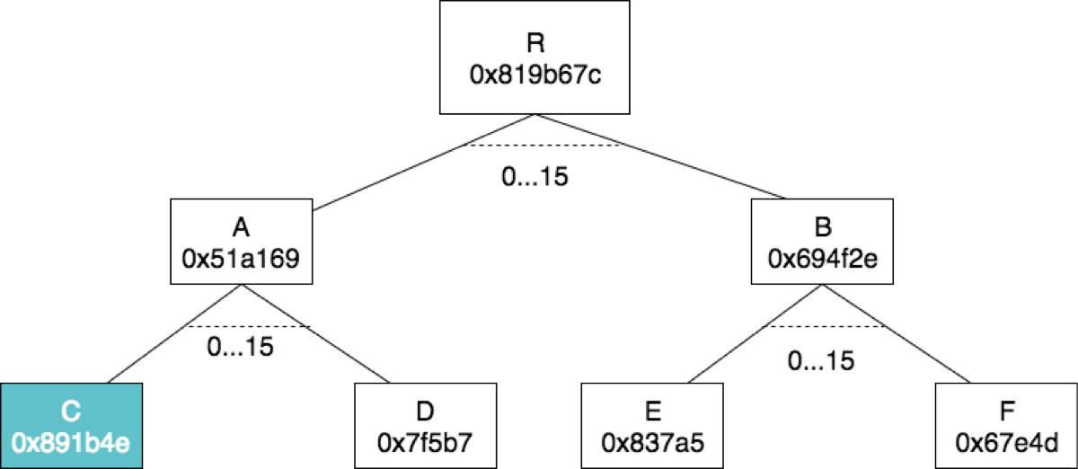
Spoiler! Day 2 Stateless Client Mechanism
Pre-state

Slide 79
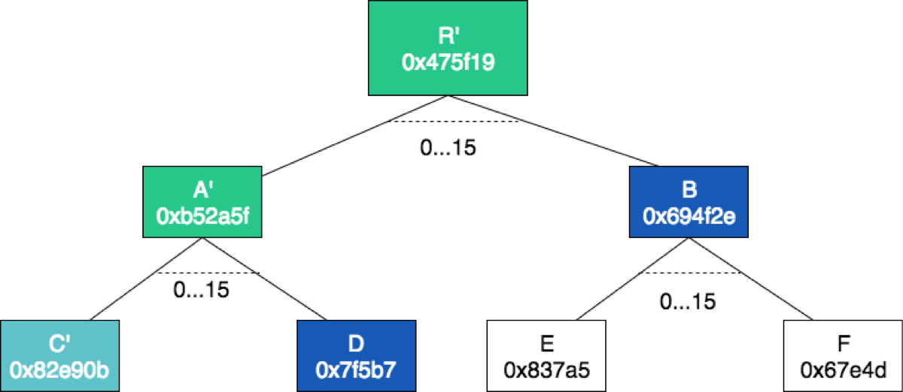
Spoiler! Day 2 Stateless Client Mechanism
Post-state
Witness: {R, A, C, D, B}
state_transition_function(state_root, collation, witness) → state_root’, read_set, write_set

Slide 80

Archival Node

Slide 81
Shard Client Components

Slide 82
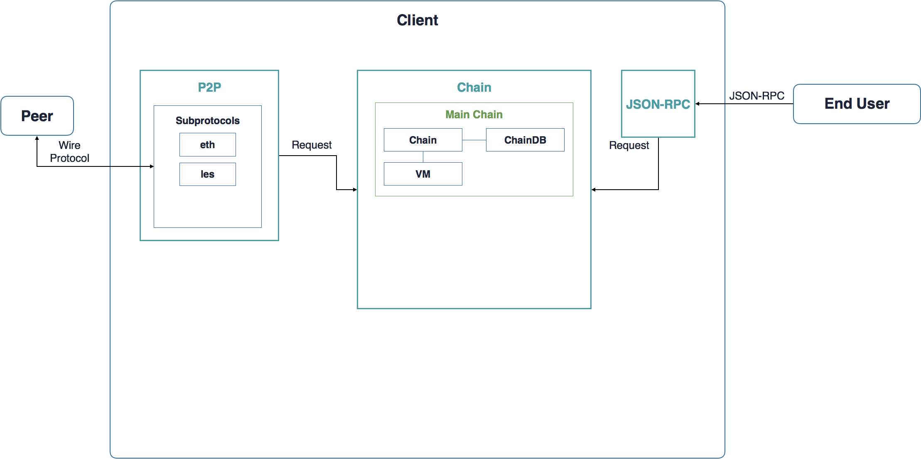

Slide 83
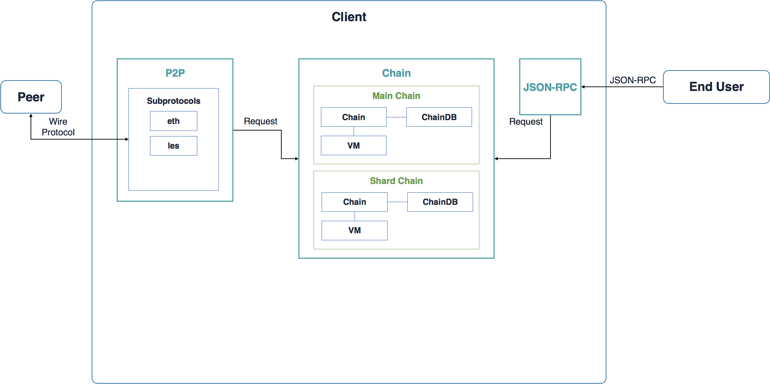
EVM? eWASM?

Slide 84
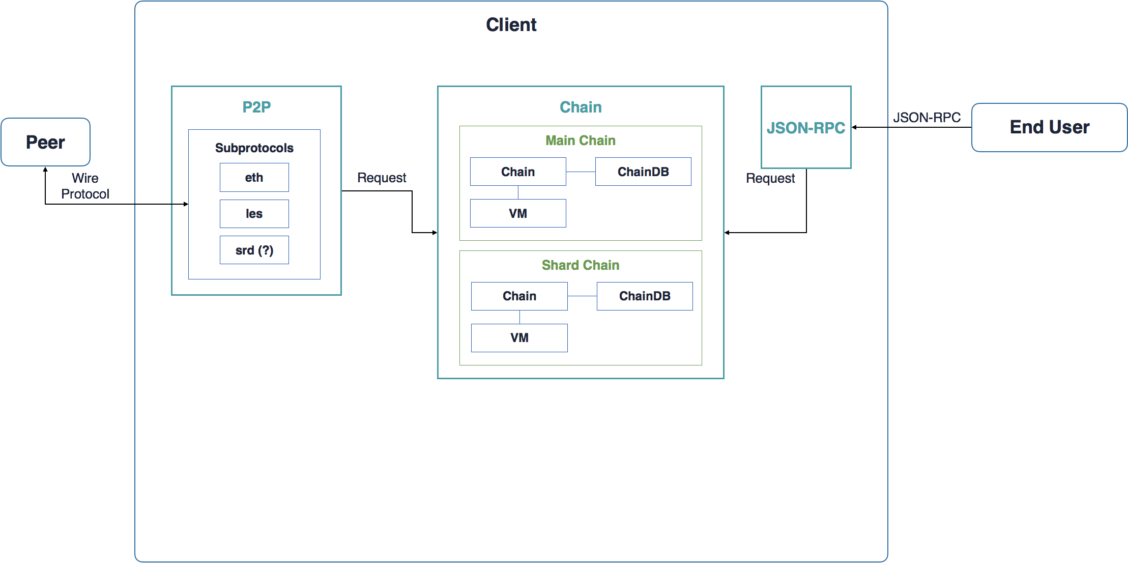
Spoiler! Day 2 P2P
sharding subprotocol

Slide 85
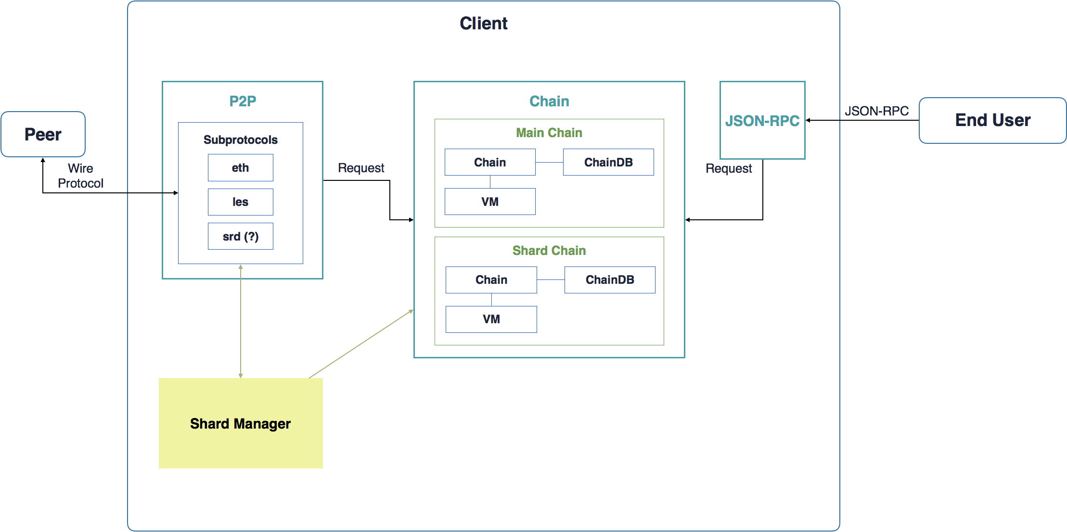
Collator
Proposer
Executor

Slide 86
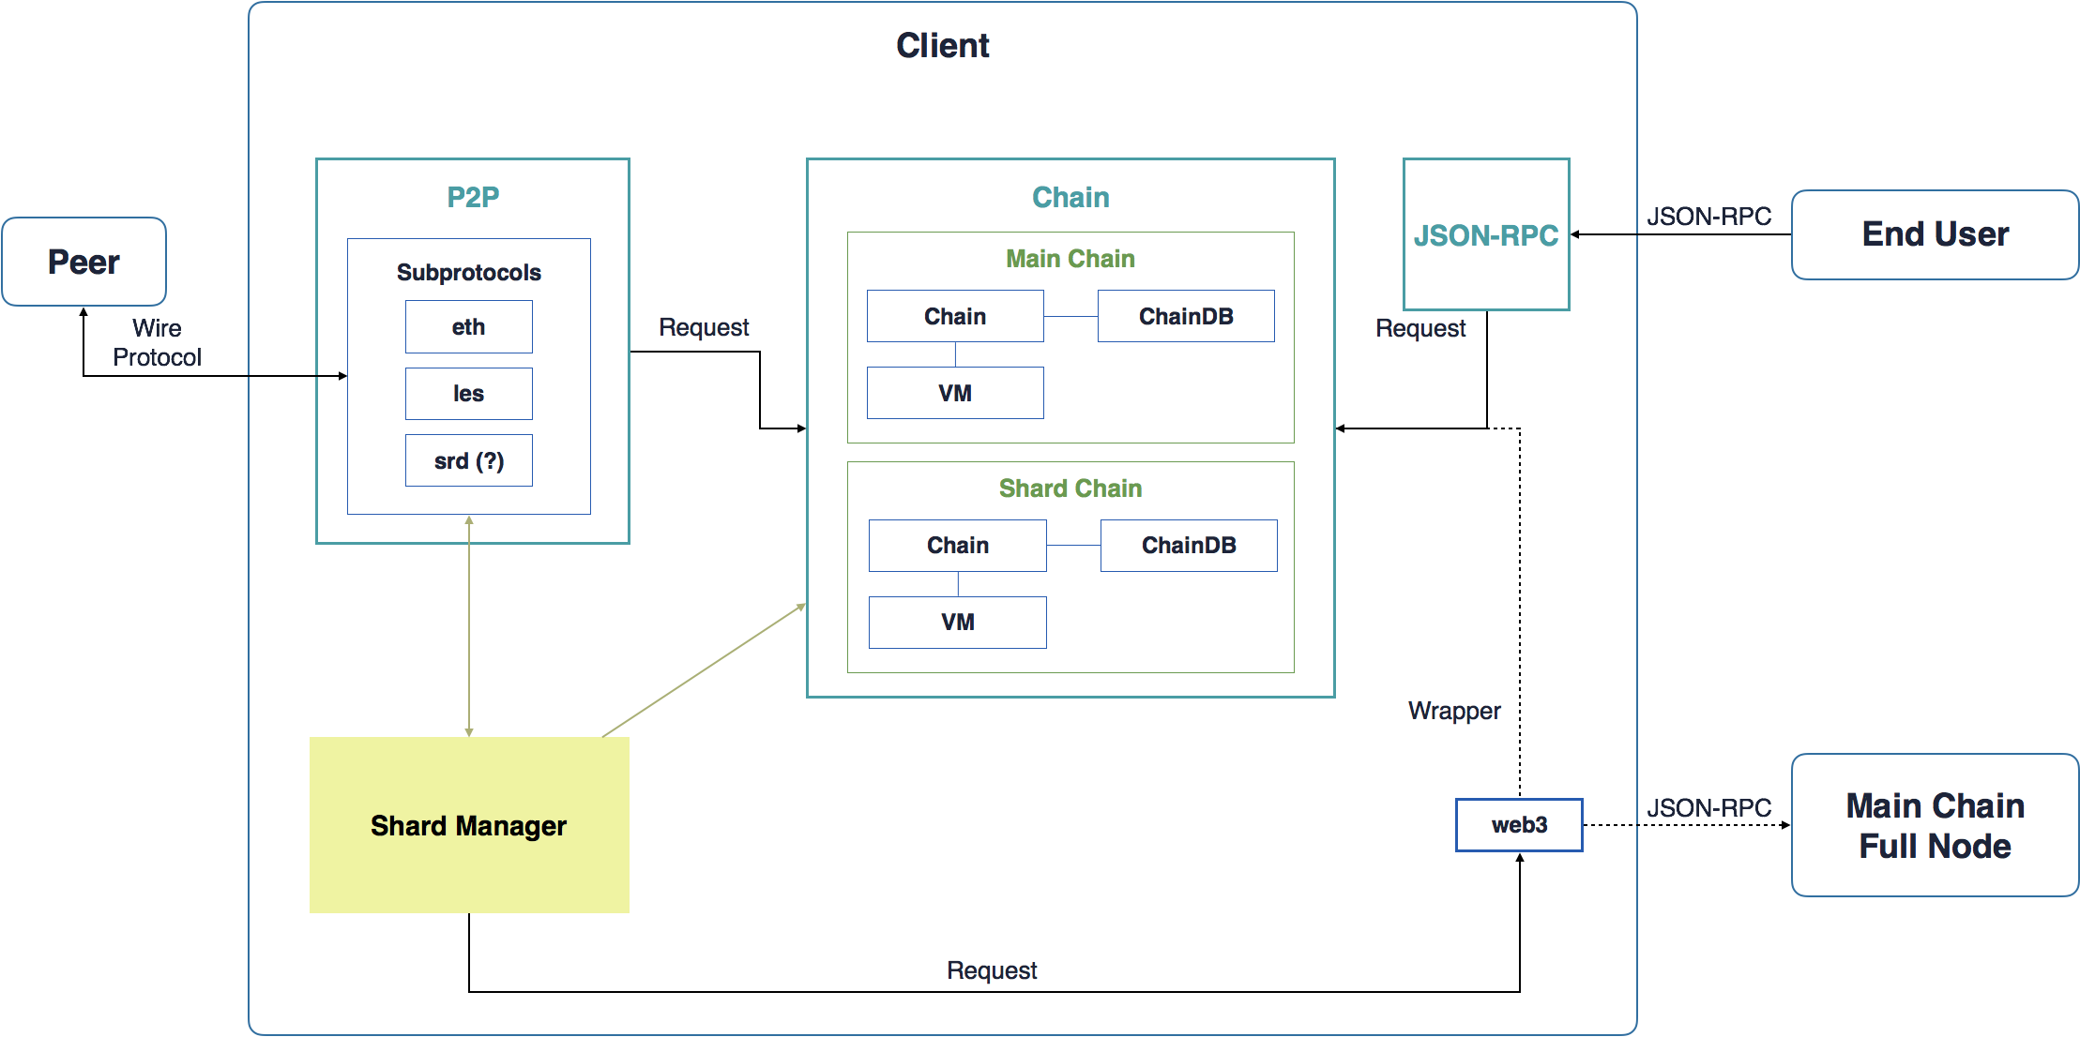

Slide 87
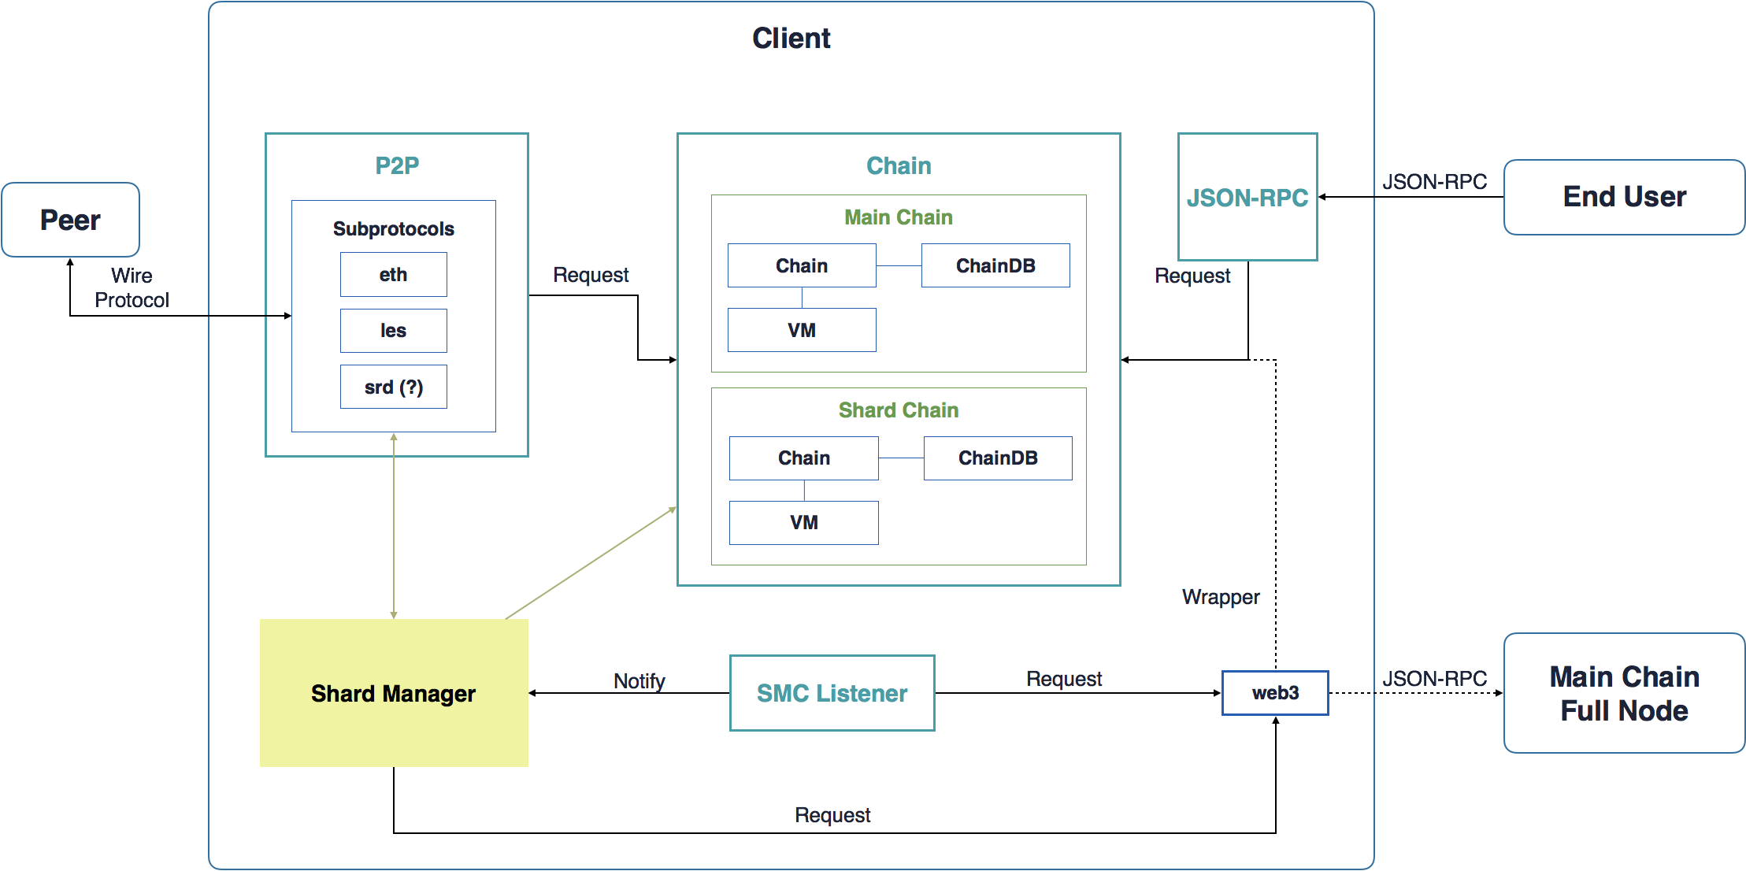

Slide 88
(New*) Roadmap

Slide 89
1
2
Phase 1
Blob shard without transactions
Proposers
Proposal commitments
Collation availability challenges
3
Basic sharding without EVM
4
5
6

Slide 90
1
Full nodes only
Asynchronous cross-contract transactions only
Account abstraction
eWASM
Asynchronous zones
Archive accumulators
Storage rent
2
Phase 2
3
EVM state transition function
4
5
6

Slide 91
Spoiler! Day 3 Cross-contract communication
1
Full nodes only
Asynchronous cross-contract transactions only
Account abstraction
eWASM
Asynchronous zones
Archive accumulators
Storage rent
2
Phase 2
3
EVM state transition function
4
5
6

Slide 92
Spoiler! Day 2 Account Abstraction and Gas Payment
1
Full nodes only
Asynchronous cross-contract transactions only
Account abstraction
eWASM
Asynchronous zones
Archive accumulators
Storage rent
2
Phase 2
3
EVM state transition function
4
5
6

Slide 93
Spoiler! Day 2 eWASM
1
Full nodes only
Asynchronous cross-contract transactions only
Account abstraction
eWASM
Asynchronous zones
Archive accumulators
Storage rent
2
Phase 2
3
EVM state transition function
4
5
6

Slide 94
Spoiler! Day 3 Cross-contract communication
1
Full nodes only
Asynchronous cross-contract transactions only
Account abstraction
eWASM
Asynchronous zones
Archive accumulators
Storage rent
2
Phase 2
3
EVM state transition function
4
5
6

Slide 95
Spoiler! Day 2 Execution-minimisation and State-minimisation
1
Full nodes only
Asynchronous cross-contract transactions only
Account abstraction
eWASM
Asynchronous zones
Archive accumulators
Storage rent
2
Phase 2
3
EVM state transition function
4
5
6

Slide 96
1
Full nodes only
Asynchronous cross-contract transactions only
Account abstraction
eWASM
Asynchronous zones
Archive accumulators
Storage rent
2
Phase 2
3
EVM state transition function
4
5
6

Slide 97
Spoiler! Day 1 Execution
1
2
Phase 3
3
Light client state protocol
Executors
Stateless clients
4
5
6

Slide 98
Spoiler! Day 2 Stateless Client Mechanism
1
2
Phase 3
3
Light client state protocol
Executors
Stateless clients
4
5
6

Slide 99
Spoiler! Day 3 Cross-contract communication
1
2
Phase 4
3
Cross-shard transactions
Zones
4
5
6

Slide 100
Spoiler! Day 3 Scalable data availability checking
1
2
Phase 5
Data availability proofs
Casper integration
Internally fork-free sharding
Manager shard
3
Tight coupling with main chain security
4
5
6

Slide 101
Spoiler! Day 3 Ethereum 2.0 End game
1
2
Phase 5
Data availability proofs
Casper integration
Internally fork-free sharding
Manager shard
3
Tight coupling with main chain security
4
5
6

Slide 102
Spoiler! Day 3 Ethereum 2.0 End game
1
2
Phase 5
Data availability proofs
Casper integration
Internally fork-free sharding
Manager shard
3
Tight coupling with main chain security
4
5
6

Slide 103
Spoiler! Day 3 Ethereum 2.0 End game
1
2
Phase 5
Data availability proofs
Casper integration
Internally fork-free sharding
Manager shard
3
Tight coupling with main chain security
4
5
6

Slide 104
Spoiler! Day 3 Ethereum 2.0 End game
1
2
Phase 6
3
Super-quadratic sharding
Load balancing
4
5
6

Slide 105
Research Topics

Slide 106
Research Topics
New Schemes

Slide 107
Research Topics
New Schemes
Vulnerability Analysis

Slide 108
Research Topics
New Schemes
Vulnerability Analysis
Optimization

Slide 109
Workshop Agenda

Slide 110
Day 1 Agenda
General Introduction 10:30 - 12:00
— Lunch: 12:00 - 13:30 —
Sharding Manager Contract 13:30 - 14:30
Proposer / Collator Separation 14:30 - 16:00
— Break: 16:00 - 16:15 —
Execution 16:15 - 17:45
Dinner starts at 19:00

Slide 111
Day 2 Agenda
eWASM 09:00 - 10:00
Execution-minimisation and State-minimisation 10:00 - 11:00
Account Abstraction and Gas Payment 11:00 - 12:00
— Lunch: 12:00 - 13:20 —
Stateless Client Mechanism 13:20 - 14:50
Access lists, Account Restriction and Parallelizability 14:50 - 15:35
— Break: 16:00 - 16:15 —
P2P Networking 15:50 - 17:20

Slide 112
Day 3 Agenda
Cross-contract Communication 09:00 - 10:30
Scalable Data Availability Checking 10:30 - 12:00
— Lunch 12:00 - 13:30 —
Security Models Mechanism Design 13:30 - 15:00
Ethereum 2.0 End-Game 15:00 - 15:45
— Closing: 15:45 - 15:55 —

Slide 113

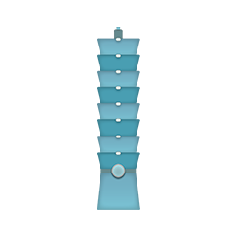

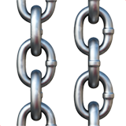



Enjoy it!

Slide 114
Thank you!

Slide 115
CREDITS
Special thanks to all people who made and share these awesome resources for free:
Taiwan Emoji Project
Presentation template designed by Slidesmash
Photographs by unsplash.com and pexels.com
Vector Icons by Matthew Skiles
Icons made by DinosoftLabs from www.flaticon.com is licensed by CC 3.0 BY

Slide 116
Presentation Design
This presentation uses the following typographies and colors:
Free Fonts used:
https://www.fontsquirrel.com/fonts/nunito
Colors used

